Slide 1
CASESTUDY ON LOGISTIC REGRESSION

Slide 2
ABSTRACT
The company(X Education) sells online courses to industry professionals. On any given day, many professionals who are interested in the courses land on their website and browse for courses.
The company markets its courses on several websites and search engines like Google. Once these people land on the website, they might browse the courses or fill up a form for the course or watch some videos. When these people fill up a form providing their email address or phone number, they are classified to be a lead.
Moreover, the company also gets leads through past referrals. Once these leads are acquired, employees from the sales team start making calls, writing emails, etc. Through this process, some of the leads get converted while most do not. The typical lead conversion rate at X education is around 30%.
However x educ gets lots of leads ,but its conversion rate is very poor. The aim of this case study is to build a model which identifies top leads who can join the course.

Slide 3
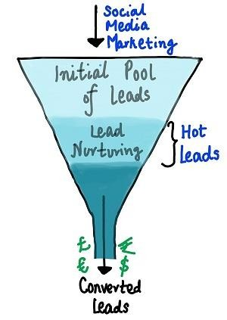
Business Understanding
Company markets its courses in several Websites.
The person/Individual who watch videos, fill up the form giving e-mail ,phone number are considered as Initial pool of Leads. The company gets leads from past referral as well.
Now, we need to Identify Hot leads i.e. potential leads who can convert as its customers.

Slide 4
Data Cleaning and Data Preparation
Initially we Read the data frame as lead data. We Inspect the Data frame such as its shape,info,describe,null values.
Check whether there are Duplicates in the data if any. In this study there are No Duplicates At first ,before Null value treatment we had 9240 Rows with 37 Columns.
Checked Null values and removed rows with Null Values are they would not impact our analysis anyway. After Removing Null Values we are Retained with 98% of Rows.

Slide 5


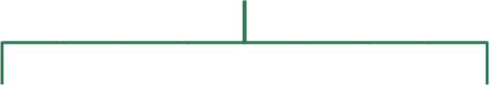
Data Preparation
After Data Cleaning the Next step in Assignment would be Data Preparation for Further Study. There are two ways in handling categorical variables
Categorical Variables
Getting Dummy Variables
Binary Mapping

Slide 6
Data Preparation
After using both the techniques binary mapping and getting Dummy variables fro multiple level categories.
The columns obtained from dummy variables are concatenated to master data frame and removed the Initial Columns.

Slide 7
CHECKING FOR OUTLIERS
Check whether we have any outliers in data using different percentiles such as(.25,.5,.75,.9,.95,.99)
If the numbers are gradually increasing it states that there are no Outliers observed in Data.
Note: If there is a drastic increase/decrease it states that there are outliers. we need to address them

Slide 8
METHODOLOGY
Test-Train Data-
Splitting data into Test-Train Data to 70-30 %.
We have almost 38% churn rate CHECK FOR CORRELATION:
Draw a heatmap to check whether there exist any high correlation between Variables.
Remove the variables which are highly correlated to remove collinearity between
variables.
Drop variables from both test and train data set.

Slide 9
MODEL BUILDING
First Run Generalised Linear Regression model (GLM) on train data and check p-values and VIFs.
Check whether its p-values are less than or equal to 0.05
Check whether VIF’s are less than 5.
Feature selection Using RFE
Running RFE with the Output Number of Variables=15
Considering the variables with good rfe_ranking

Slide 10
MANUAL FEATURE ELIMINATION(Using
P-Values & VIF’s)
Add constant to X-Train data and Run GLM Model
Now check the summary of stats with 15 features. Check whether p-values are less
than 0.05.Remove one by one variable if grater than 0.05
Now get predicted values for Y-Train data
Creating a new column predicted & Assign 1 if converted >0.5 else 0
Now check VIF’s.If they are not significant drop the feature and continue the above steps till we get significant VIF’s & P-values
the overall accuracy is 77.57%

Slide 11
MODEL EVALUATION
There are few measures to assess or Model.
Accuracy
Sensitivity & Specificity
Optimal Cut-off using ROC
Precision & Recall

Slide 12
Confusion Matrices for Test & Train Data
Create Confusion Matrix to know how many labels are actually converted and how many are predicted
Train data Test Data
Actual/Predicte d | Not converted | Converted
Not Converted | 2978 | 927
Converted | 400 | 2046
Actual/Predi cted | Not converted | Converted
Not Converted | 1387 | 347
Converted | 224 | 765

Slide 13
Accuracy
Accuracy=Correctly Predicted Labels/Total No of Labels
Using confusion Matrix in previous Slide we got accuracy of 79% which seems to be a good number to begin with
Accuracy for Train Data=0.77 Accuracy for Test Data=0.79
Is Accuracy Enough to access the goodness of Model?→No
-----We have two most commonly used metrics to access the model(Sensitivity & Specificity)

Slide 14
Sensitivity and Specificity
SENSITIVITY
Sensitivity=No of actual yesses correctly predicted/Total No of actual Yesses
Sensitivity for Train Data=79.68% Sensitivity for Test Data=77.35%
SPECIFICITY
Specificity=No of actual Nos correctly Predicted/Total No of Nos
Specificity for Train Data=80.02% Sensitivity for Test Data=79.99%

Slide 15
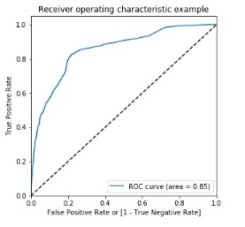
Optimal Cut-off using ROC
The higher the area under the curve,
the better the model is.
From the ROC,we got Optimal cut-off=0.4

Slide 16
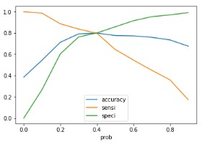
Plotting Accuracy,sensitivy & Specificity

Slide 17
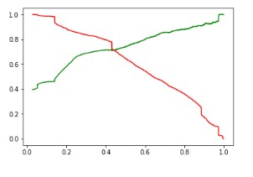
Precision & Recall
Apart from Specificity & Sensitivity we have other two more widely used Metrics:
Precision: Probability that a predicted Yes is actually ‘YES’
Precision=TP/(TP+FP)
Recall: Probability that a Yes case is predicted as such.
Recall=TP/(TP+FN)
F1 Score=Which essentially combines both precision & Recall. Harmonic Mean of Precision & Recall
=2*((P*R)/(P+R))

Slide 18
RECOMMENDATIONS

Slide 19



